Slide 1
Introduction

Slide 2
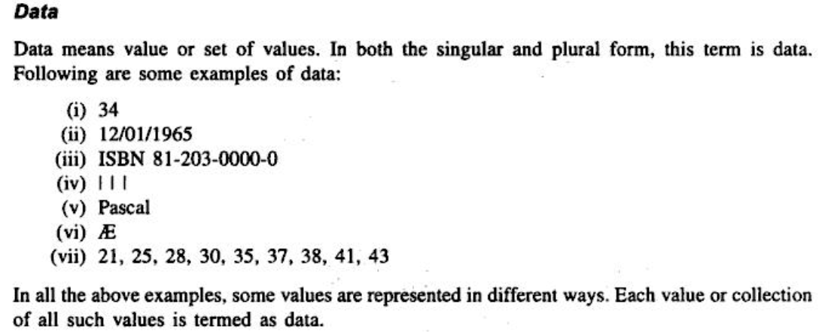
What is Data?

Slide 3
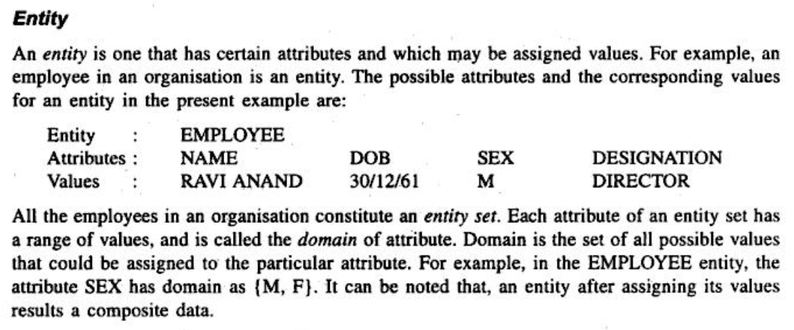
What is Entity?

Slide 4
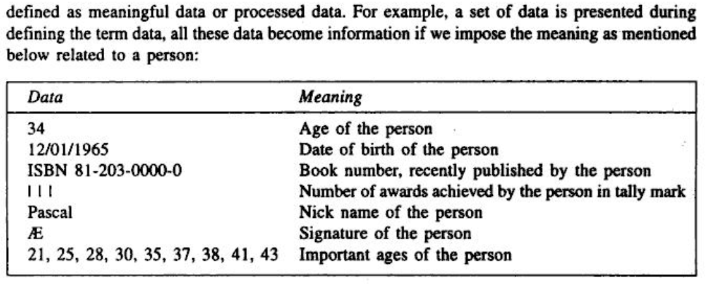
What is Information?

Slide 5
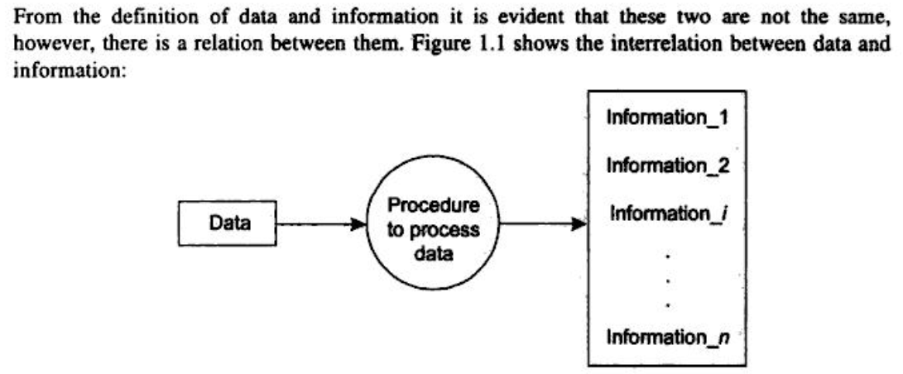
Difference Between Data and Information?

Slide 6
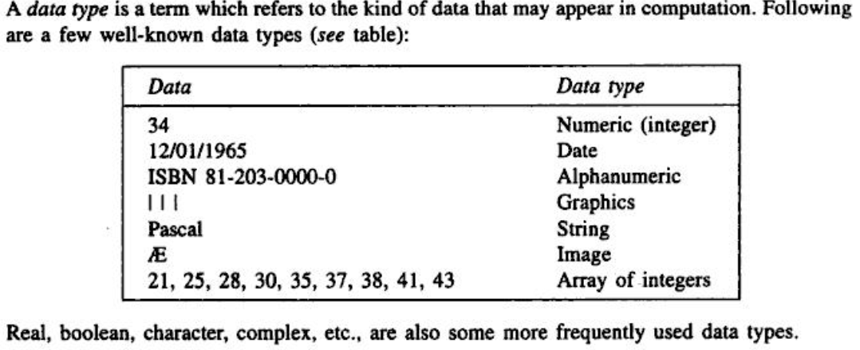
What is Data Type?

Slide 7
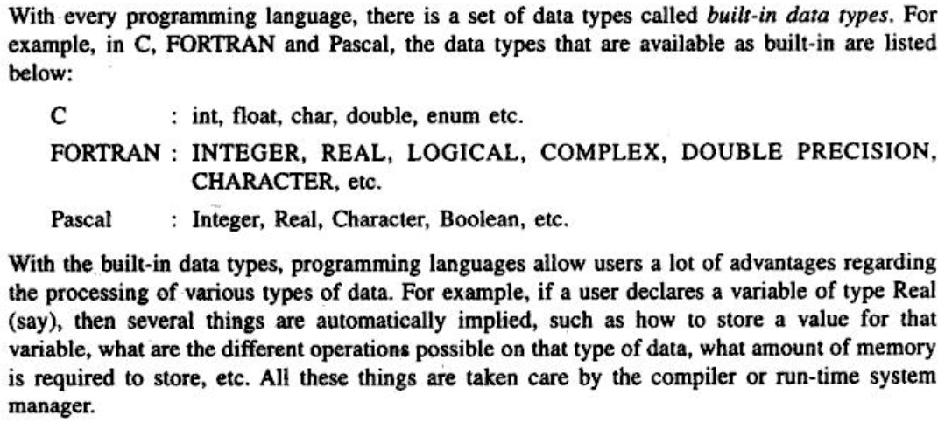
What is Built-in Data Type?

Slide 8
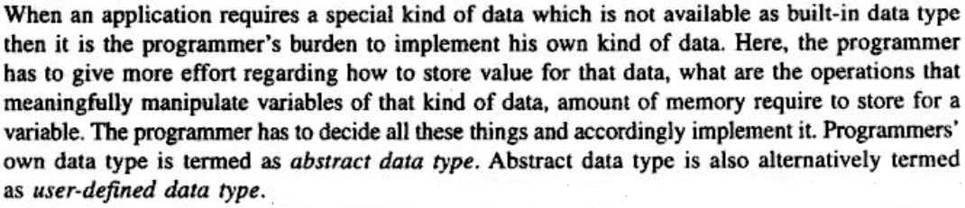
What is Abstract Data Type?

Slide 9
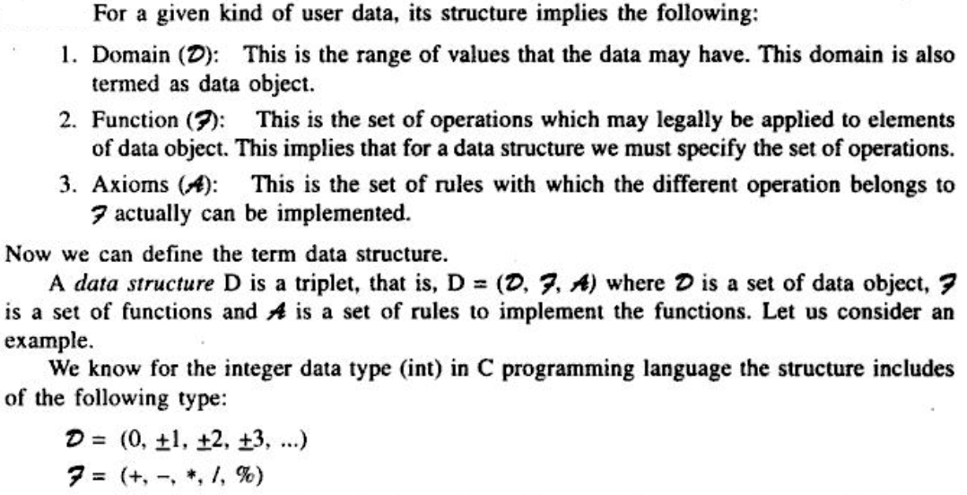
Data Structure

Slide 10
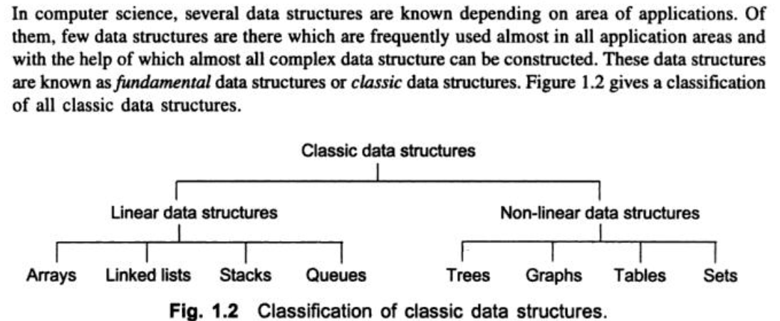
Overview of Data Structure

Slide 11
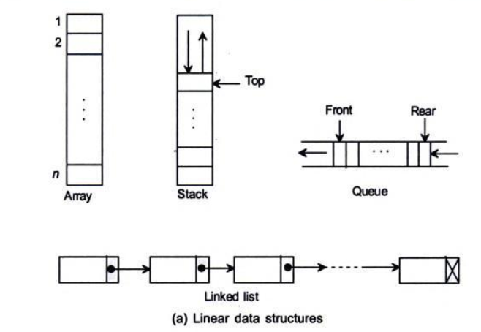
Linear Data Structures

Slide 12
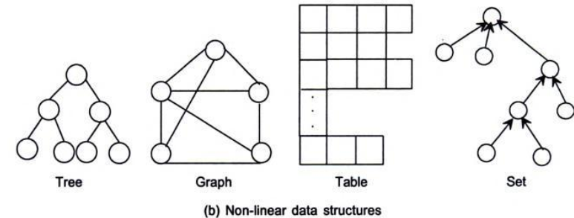
Non-Linear Data Structures

Slide 13
Thank you

